Slide 1

SkinCare AI
CNN-Based Preliminary Skin Disease Image Classification
Deep Learning & Computer Vision project
Realized by : Souha Guezguez

Slide 2
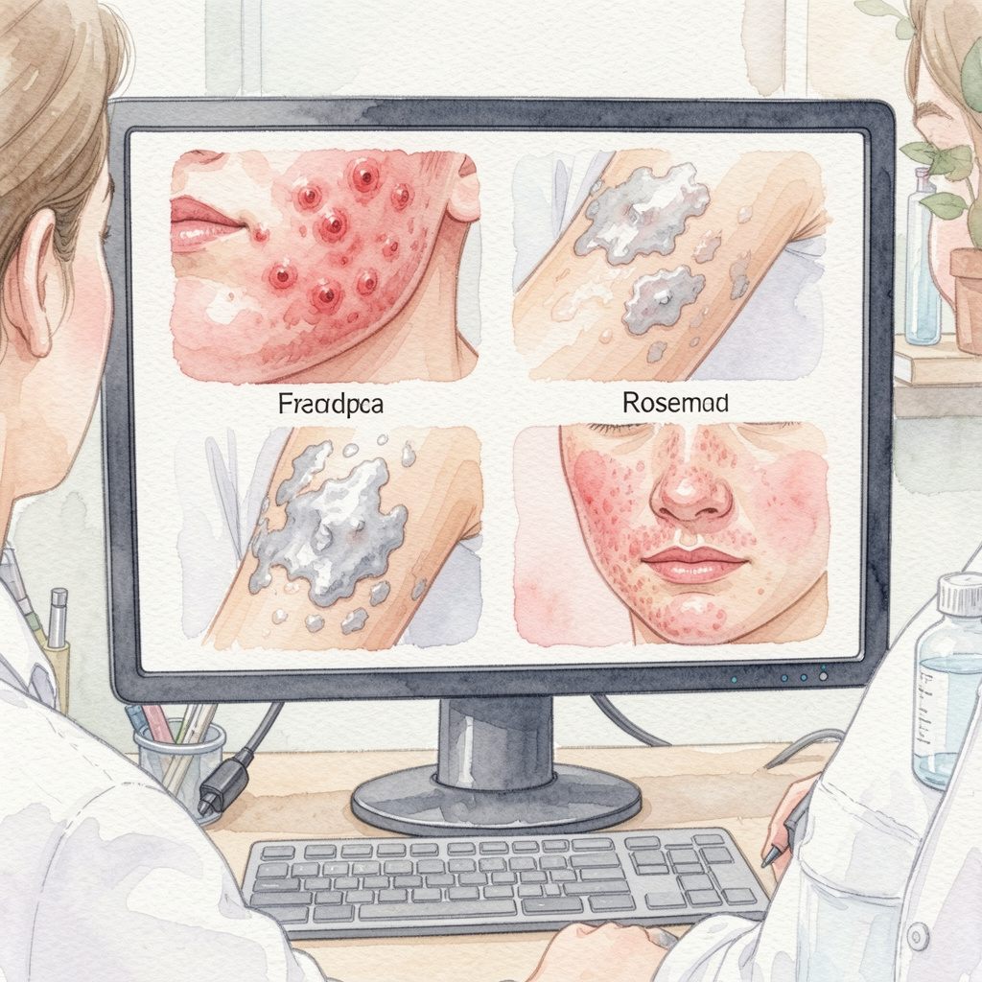
Problem Statement & Objectives
Problem :
Dermatological conditions can look visually similar.
Manual diagnosis requires medical expertise.
The project focuses on preliminary image classification, not medical diagnosis.
Objective
Classify a skin image into one of four selected classes.

Slide 3
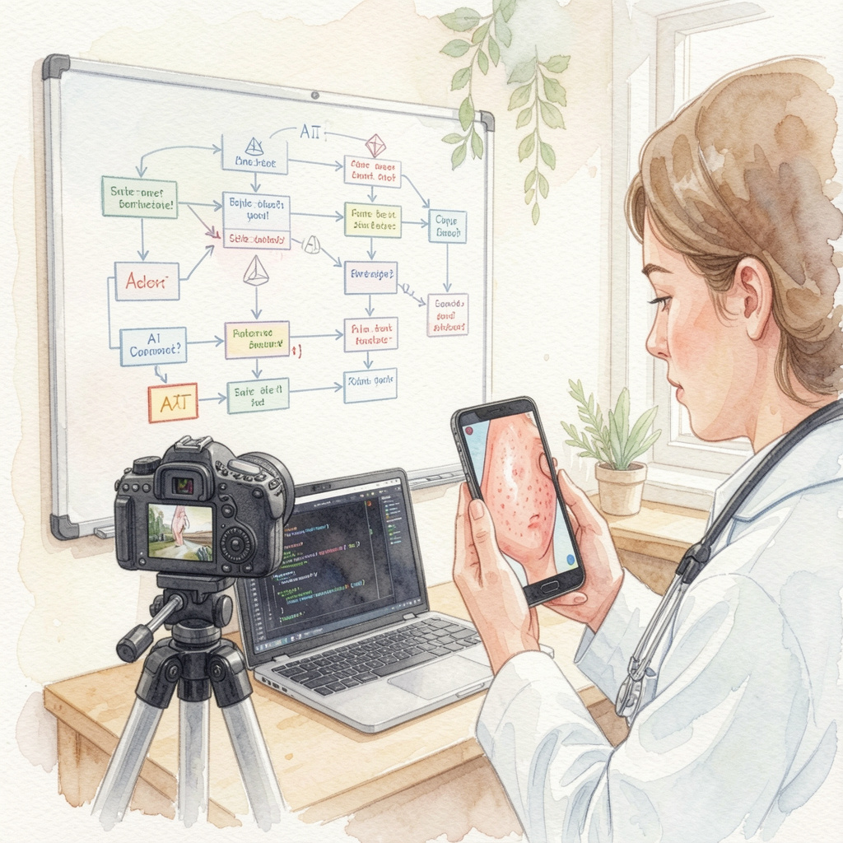
Selected classes
Acne
Eczema
Psoriasis
Rosacea

Slide 4


Dataset & Preprocessing
Dataset
Skin Disease Dataset from Kaggle.
Original dataset contained multiple classes.
Four classes were selected for a focused classification task.
Unknown_Normal was excluded after visual inspection because it contained noisy non-skin images.
Preprocessing
Images resized to 224 × 224 pixels.
MobileNetV2 preprocess_input used.
Training and validation subsets prepared from train folder.
Test folder used only for final evaluation.
Why preprocessing?
Standardizes input size.
Matches the format expected by the pre-trained model.
Improves training stability and reproducibility.

Slide 5

Models Tested
Simple CNN
Baseline model trained from scratch. Useful for comparison, but overfitting observed.
Improved CNN
Added Dropout, Batch Normalization and callbacks. Performance decreased, showing poor generalization.
MobileNetV2 TL
Frozen pre-trained backbone with a new classification head. Best and most stable model.
Fine-tuning
Last MobileNetV2 layers unfrozen with a small learning rate. Tested but slightly reduced performance.

Slide 6

Results Comparison & Model Selection
Test accuracy comparison
Simple CNN
51.88%
CNN + Dropout + BN
24.23%
MobileNetV2 TL
70.65%
Fine-tuning
67.00%
Final model selected
MobileNetV2 Transfer Learning — Phase 1
Best test accuracy: 70.65%
Macro F1-score: 0.72
Weighted F1-score: 0.70
Fine-tuning was tested, but did not improve the final score.

Slide 7
Conclusion & Future Work
Key conclusions
The project is a Deep Learning + Computer Vision application.
CNNs trained from scratch were less effective on the limited dataset.
Transfer Learning with MobileNetV2 achieved the best generalization.
The final pipeline was integrated into a Streamlit application.
Future work
Use a larger and cleaner dermatology dataset.
Add more skin disease classes.
Test EfficientNet or Vision Transformers.
Improve explainability with Grad-CAM.
Deploy the Streamlit app online.

